Slide 1
Abstractive News Summarization for Bangla Documents Using LSTM Network Model
Presented By -
Md.Shajib Hossain (19101250)
Md. Muhimenul Mubin
Mehnaz Ara Fazal, ST
Sania Azhmee Bhuiyan, RA

Slide 2
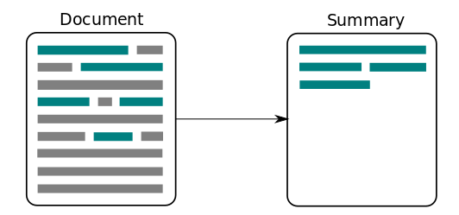
Introduction
2 types of summarization -
Abstractive
Extractive
Novel system for abstractive summarization of Bengali news articles.
LSTM network model with attention at encoder-decoder, designed to generate human-like sentences summarizing Bengali news documents
demonstrating significant improvement over existing approaches

Slide 3
Motivation and Purpose
To generate a meaningful idea over a large documents and save time
to contribute to the field of abstractive summarization, particularly in languages other than English, and to provide a valuable resource for Bengali news summarization.

Slide 4
Planning
Initially we are planning find suitable dataset for Bangla news
To pre-processing the data such as removing stop words and special character
To use LSTM model
To compare between human generated summary and our automated summary by our proposed model

Slide 5
Challenges
Finding the suitable dataset
Learn the techniques to build our purposed LSTM model
Gather Enough amount of News in Bangali language

Slide 6
Conclusion
Looking for suitable dataset In Bangali Language

